Slide 1
Lecture 2
Introduction to GAMS
David Roland-Holst and Enkhbayar Shagdar
UC Berkeley and ERINA
Training Workshop
A Prototype CGE Model for Mongolia
9 July 2013
National Statistical Office of Mongolia, Ulaan Baatar

Slide 2
Moving to GAMS
The Excel version of 1-2-3 is easily accessible, but must be highly simplified to be tractable.
Using a higher level programming language enables us to include more economic structure and behavior.
The Generalized Algebraic Modeling System (GAMS) is the language of choice for this kind of work.

Slide 3
Accessing GAMS
The homepage of the GAMS corporation (www.gams.com) contains a lot of useful information.
From the homepage, a full user guide can be downloaded at www.gams.com/docs/document.htm; the user guide contains the syntax for all GAMS commands and very helpful as a reference when writing GAMS models. Note that the user guide is also available via the Help function in GAMS-IDE.
All readers are advised to study the introductory chapter of this manual when starting to learn the GAMS software.

Slide 4
Download and Installation
There is a free version of GAMS available for installation on your own computer. This is a limited version of GAMS, which cannot solve large problems, but it can be used for the sample models in this course.
A free copy of the restricted, student version is available for download at http://www.gams.com/download

Slide 5
Introduction to GAMS
Description:
automates the process of going from a mathematical statement of the problem to the solution.
GAMS transforms the mathematical representation to representations required by specific Solver engines like OSL,CPLEX,..
models and solves complex linear, nonlinear and integer programming problems.
lets you build your model in a natural, logical structure using compact algebraic statements.
Typical use:
Optimization

Slide 6
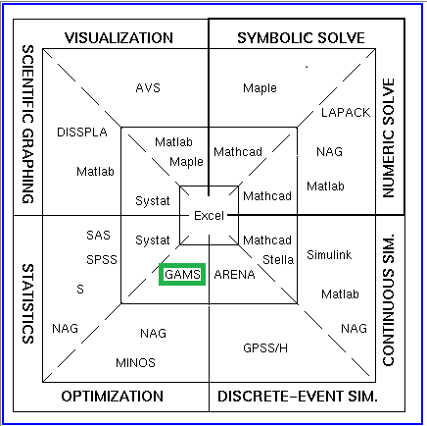
Scientific Software Comparison Chart
As you move away from the centre of the diagram, the software is more advanced,
but often less friendly.
Try the software in the second tier first if you are looking for a middle way.

Slide 7
GAMS for CGE Models: A Schematic View
Social Accounting Matrix
Econometric Parameter Estimates
Development
Policy Scenarios
CGE Model
Baseline Calibration Data
Simulation
Numerical Results
GIS Mapping
Analysis
Box Color Key to Software Implementation:
Green – Microsoft Excel
Yellow – GAMS

Slide 8
Sample Transportation Problem
Satisfy market demand, but with minimal costs of transporting the goods from producers to the markets
we are given the supplies at several plants and the demands at several markets for a single commodity, and we are given the unit costs of shipping the commodity from plants to markets. The economic question is: how much shipment should there be between each plant and each market so as to minimize total transport cost?

Slide 9
Transportation Problem (cont.)
Indices:
i = plants
j = markets
Given Data:
ai = supply of commodity of plant i (in cases)
bj = demand for commodity at market j (cases)
cij = cost per unit shipment between plant i and market j ($/case)
Variables:
costs
xij = amount of commodity to ship from plant i to market j (cases),
where xij >= 0, for all i, j

Slide 10
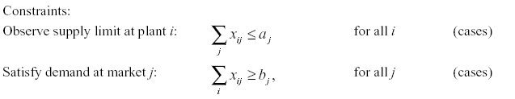
Transportation Problem (cont.)
i

Slide 11
GAMS Program
Model definition and Solve statement
Model definition
what is in the model (indices): sets
data: scalars, parameters, tables
What you are looking for: variables
relationships: equations
Model statement
Solve statement

Slide 12
Defining Model Components
Declaration
declaring the existence of something and giving it a unique name – “identifier”
Definition/Assignment
giving a specific value or form
e.g., labels - set elements

Slide 13
Model Components: Sets
Indices
Group of elements with similar characteristics
Define what you are considering in the model
Producers, markets, time periods…

Slide 14
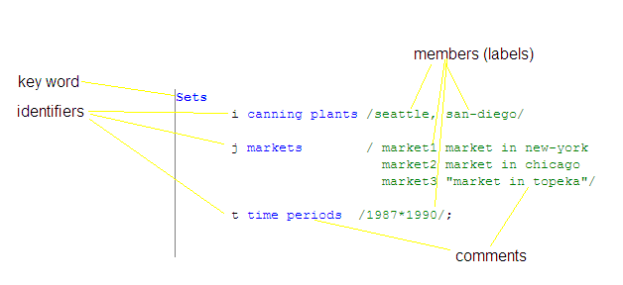
Set: declaration and definition
Notes:
Declaration, assignment of members

Slide 15
Data
Describe what you know
Different presentation of data: dimensionality
Scalars, parameters, and tables

Slide 16
Scalars
A number
keyword
description
value
identifier

Slide 17
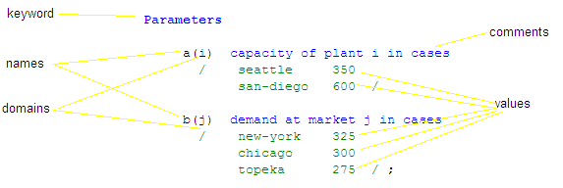
Parameters: declaration and definition
Characteristics of set elements

Slide 18
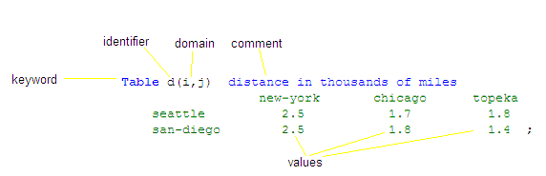
Tables
description

Slide 19

Direct assignment of data values
Example 1: declare parameter c and assign its value
Valid only if the values of f and d(i,j) are previously assigned
Example 2: Assignment of a value to an element
Notes:
Math operators – both in data assignment and equations

Slide 20
Exponent operator
x**n
x should always have a positive value
n can be any number
power(x,n)
positive or negative value of x
n is integer

Slide 21
Index Operations
sum
summation over controlling index,
prod
product over controlling index
smin, smax
minimum and maximum over controlling index

Slide 22

Model Components: Variables
What you are looking for
Declaration, assignment of type, assignment of bounds and/or initial values
Notes:
The decision variables (or endogenous variables ) of a GAMS-expressed model must be declared with a Variables statement. Each variable is given a name, a domain if appropriate, and (optionally) text.
The z variable is declared without a domain because it is a scalar quantity. Every GAMS optimization model must contain one such variable to serve as the quantity to be minimized or maximized.

Slide 23
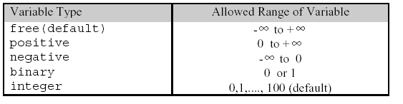
Variable Types
Notes:
The variable that serves as the quantity to be optimized must be a scalar and must be of the free type. In our transportation example, z is kept free by default, but x(i,j) is constrained to non-negativity

Slide 24
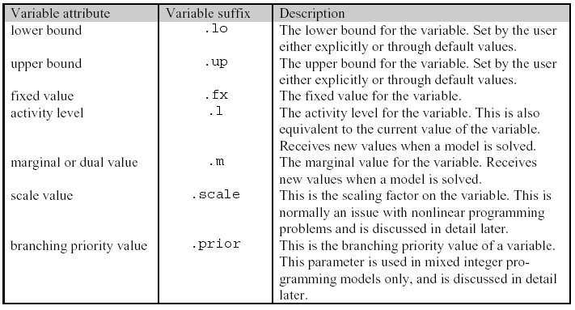
Variable attributes
Example: y.fx = 1000;
Notes:
An important difference between parameters and variables is that an additional set of keywords can be used to specify various attributes of variables. A GAMS parameter has one number associated with each unique label combination. A variable, on the other hand, has six
Dual variable – scarcity of resources

Slide 25
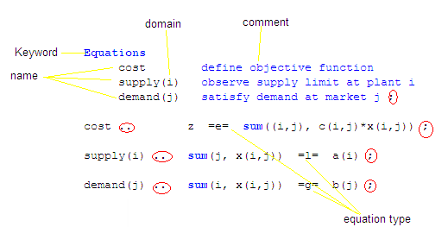
Model Components: Equations
Relationships among variables and parameters
Declaration, definition
description
Notes:
Whenever a group of equations or inequalities has the same algebraic structure, all the members of the group are created simultaneously, not individually.
Keep in mind that the word Equation has a broad meaning in GAMS. It encompasses both equality and inequality relationships, and a GAMS equation with a single name can refer to one or several of these relationships. For example, cost has no domain so it is a single equation, but supply refers to a set of inequalities defined over the domain i.
Equations define type of the model – linear, nonlinear…

Slide 26
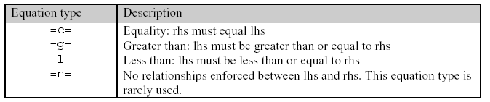
Equation Types

Slide 27
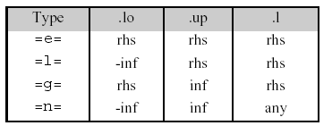
Equation Values
Notes:
New slide

Slide 28
Quick Note: “=“ and “=e=“
“=“
used only in direct assignments
gives a desired value to a parameter
executed before solver is called
must not involve variables
“=e=“
used only in equation definitions
executed after the solver is called
must contain variables

Slide 29
Model Components: Model statement
Model – collection of equations
Declaration and definition
Examples:
Notes:
Just the names of the equations, no domains

Slide 30
Types of Problems
Model Type | Description
LP | Linear Programming. There are no nonlinear terms or discrete (binary or integer) variables in the model
NLP | Nonlinear programming. There are nonlinear terms involving only “smooth” functions in the model, but no discrete variables
MIP, MINLP | Mixed Integer Programming. The model can contain discrete (integer of binary) variables
Other | DNLP, RMIP, MPEC, MCP, CNS
Notes:
Smooth functions - is one that is infinitely differentiable, i.e., has derivatives of all finite orders

Slide 31
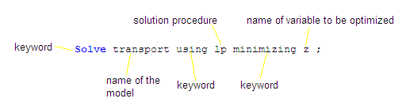
Model Components: Solve statement
Objective variable: scalar and type free

Slide 32
Display Statement
Only non-default values are displayed
Default value is generally zero
for the .lo and .up subtypes of variables and equations the default values can be zero, -INF or +INF
Display control examples:
option decimals = 1; - number of digits after decimal point for all displayed variables
option x : 5; - number of digits after decimal point for variable x;

Slide 33
Solve execution
Model is translated into Solver language
Comprehension aid is written to output
Error check, if error – program termination
Solver solves the model
GAMS reports the status of the solution and load solution values from Solver

Slide 34
GAMS Output
Reports results, facilitates debugging
Echo Print
Reference Map
Equation Listing
Column Listing
Model Statistics
Status Report Solver report
Solution Report
Report Summary
Results

Slide 35
Echo Print
Copy of input file with line numbers
Dollar-print-control statements
output control
start in column 1
examples:
$Title TEXT print TEXT on top of each page
$Ontext
$Offtext comments
$Offlisting no printing of the input file

Slide 36
Reference Map
Summaries of the input file for debugging purposes
Two parts of cross-reference map
alphabetical list of all entities and a coded reference of each appearance
List of all entries grouped by type

Slide 37
Equation Listing
Does GAMS generate the model you intended?
Describe equations for specific values of set elements and parameters
Nonlinear system – first order Taylor approximation (i.e. linear approximation)

Slide 38
Column Listing
shows the coefficients of three specific variables for each generic variable
control of equation and column listing:
option limrow = r, limcol = c ;
r – desired number of equations
c – desired number of columns

Slide 39
Model Statistics
BLOCK counts – number of generic equations and variables
SINGLE counts refer to individual equations and variables
NON ZERO ELEMENTS - number of non-zero coefficients in the problem matrix
NONLINEAR N-Z – number of nonlinear entries in nonlinear models

Slide 40
Model Statistics (cont.)
CODE LENGTH, DERIVATIVE POOL, CONSTANT POOL – type of nonlinearity in nonlinear models
GENERATION TIME - time used since the syntax check finished

Slide 41
Status Report
solve summary
Desired SOLVER STATUS: 1 NORMAL COMPLETION
Desired MODEL STATUS:
Linear model: 1 OPTIMAL
Nonlinear model: 2 LOCALLY OPTIMAL
Integer model: 8 INTEGER SOLUTION

Slide 42

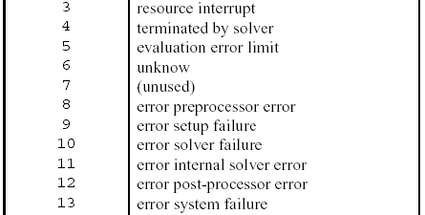
Solver Status

Slide 43
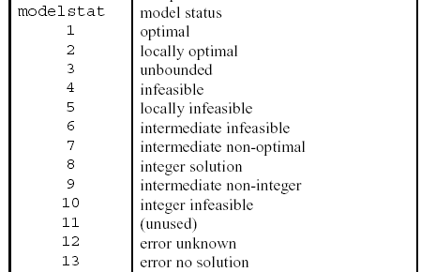
Model Status

Slide 44
Solver Report
message identifying the solver and its authors
diagnostic messages if anything unusual was detected
specific performance details

Slide 45
Solution Report
Results of optimization
Four levels of equations – low bound, level value, upper bound, and marginal
Values
“.” – zero
EPS – close to zero
INFES - infeasible
NOPT - marginal values of the wrong sign
UNBND – unbounded
Turned off by line: option solprint = off

Slide 46
Report Summary
total number of non-optimal, infeasible, and unbounded rows and columns
INFES – row/column is infeasible. The level value is not between upper and lower bounds
NOPT – row/column is non-optimal. Marginal value is incorrect
UNBND – row/column is unbounded

Slide 47
Error Report
coded message following the line with error
Look for ****
contain a "$" directly below the point at which the compiler thinks the error occurred

Slide 48
Debugging Tips
Always check carefully for the cause of the first error
Look at the previous line (especially for missing semicolons) if nothing seems obvious
More at:
http://ageco.tamu.edu/faculty/mccarl/641clas/04_641_model_inspection_error.pdf

Slide 49
Remarks
You are free to use either upper- or lower- case letters
GAMS treats singular and plural synonymously
E.g., Set and Sets
Multi-word names are not allowed. Use hyphens
E.g., ‘New-York’ instead of ‘New York’
Tips:
Use “match parentheses” button
Use “Alt” key to select a column

Slide 50
GAMS Integrated Development Environment (IDE)
Most users of GAMS can run the system in the Integrated Development Environment (IDE).
When GAMS-IDE is started, a window will appear with a menu bar along the top and a main Edit Window for GAMS applications. As with most such systems, input and output operations are controlled by the File pull down menu, with other menu items used in edit operations, and in running the GAMS system.
The IDE version provides for standard, mouse-driven editing of input files in the main GAMS Edit Window. If the appropriate file is not already displayed, use the New or Open commands on the File menu to activate one. Then create or correct the file with the mouse and tools provided on the Edit and Search menus. The Matching Parenthesis button helps with the many parentheses in GAMS by skipping the cursor to the parenthesis that corresponds to the one it is now positioned in front of. The Find in file is also a useful tool, if you work with a complex model.

Slide 51
IDE - Continued
Users should begin each session by selecting a "project". A project is a system file you save but never have to touch. Still, its location is important because the folder (directory) of the current project file is where (.gms) input and (.lst) output files are saved by default.
This allows you to easily keep all the input and output files for any task together in the same directory, and use different directories for different projects.
The starting project file (if any) is shown at the top of the main GAMS window.

Slide 52
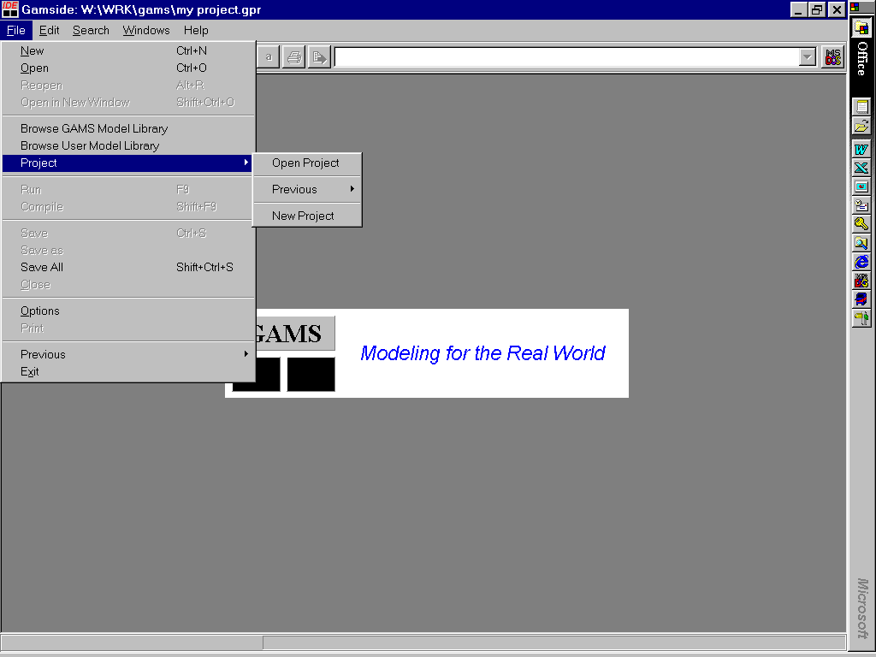
Initiating a Project
In the picture below, the starting project file is “W:\WRK\GAMS\my project.gpr”. To select another, or create a new one, use the Project item on the File menu.

Slide 53
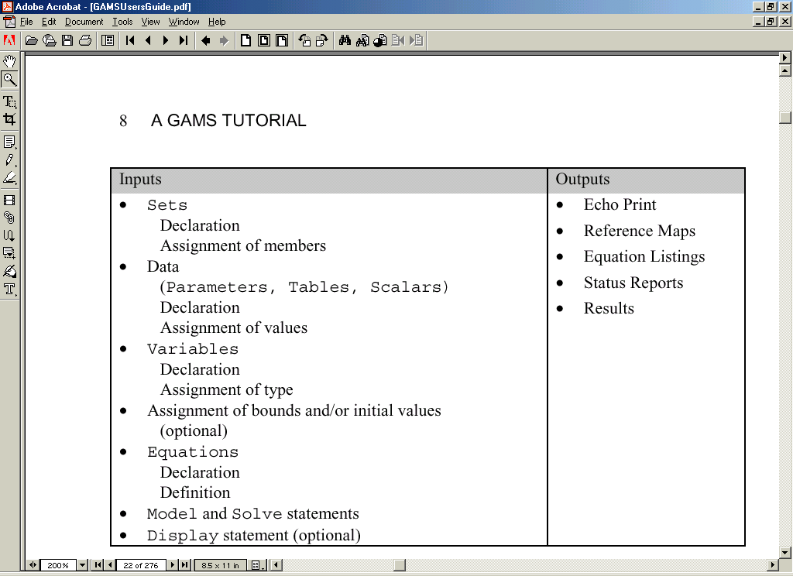
GAMS syntax: the manual

Slide 54
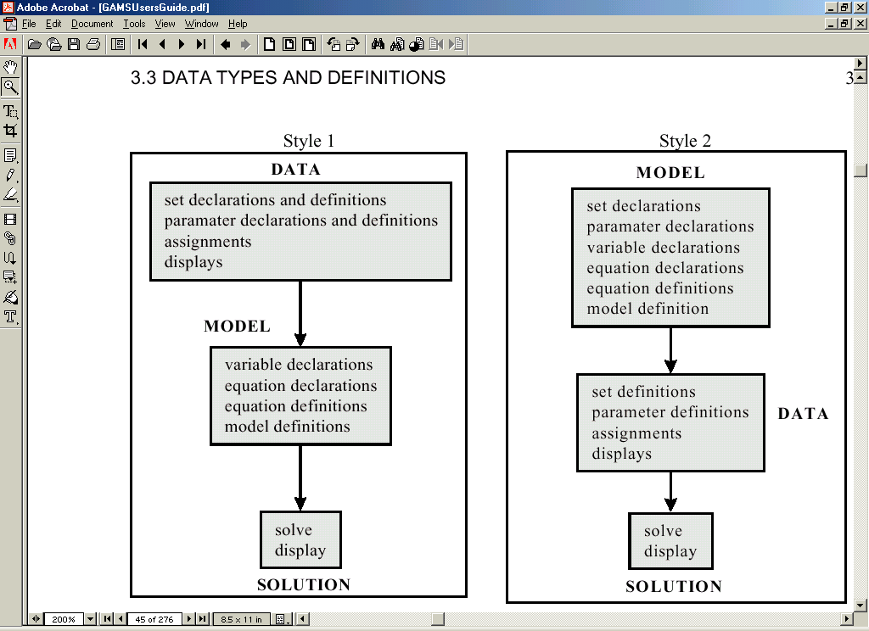
GAMS logic: the manual

Slide 55
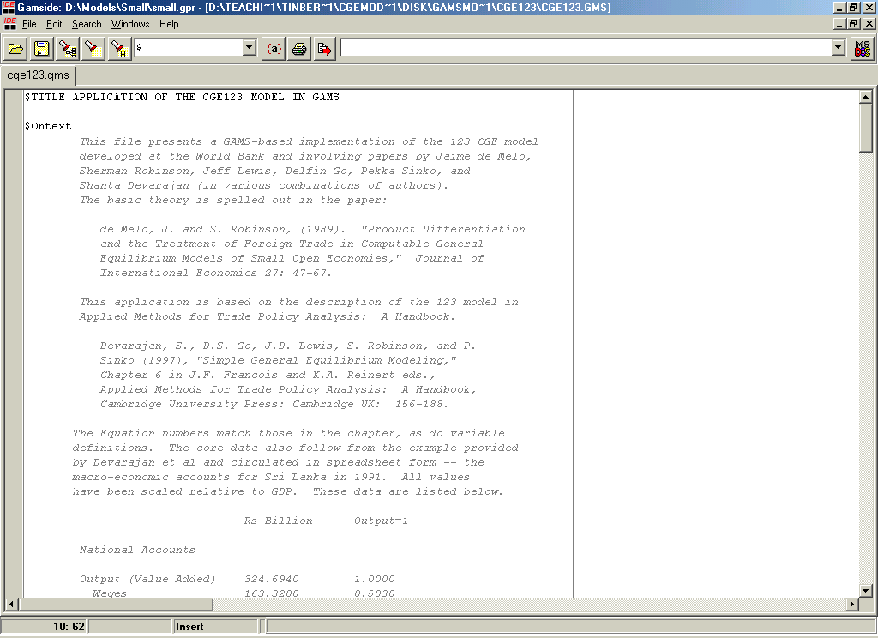
GAMS-based 123 model

Slide 56
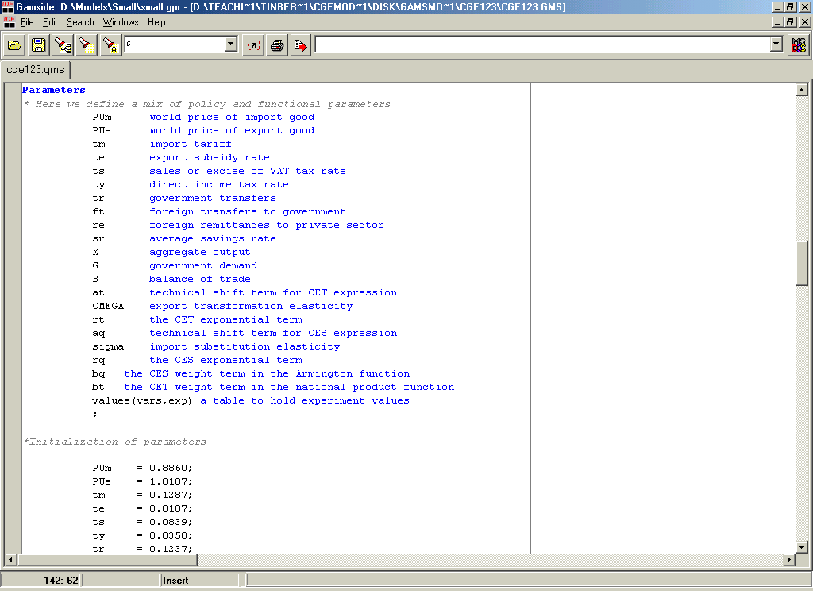
Parameter declarations

Slide 57
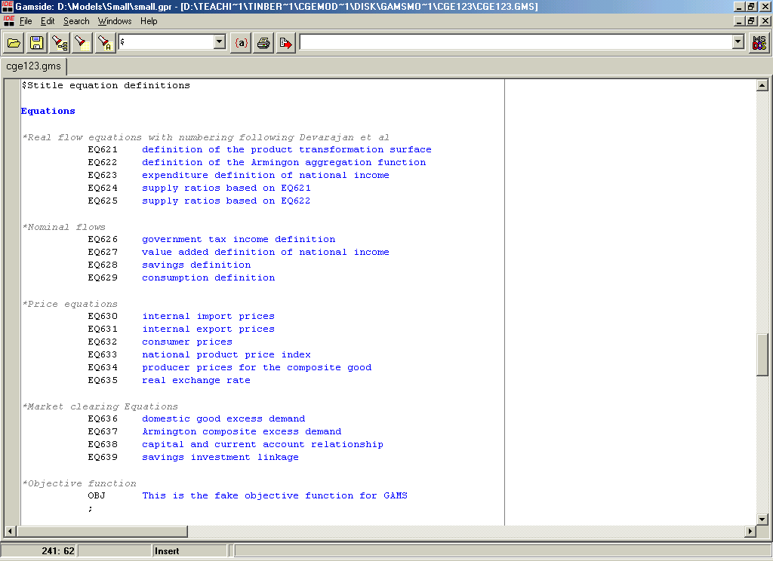
Equation definitions

Slide 58
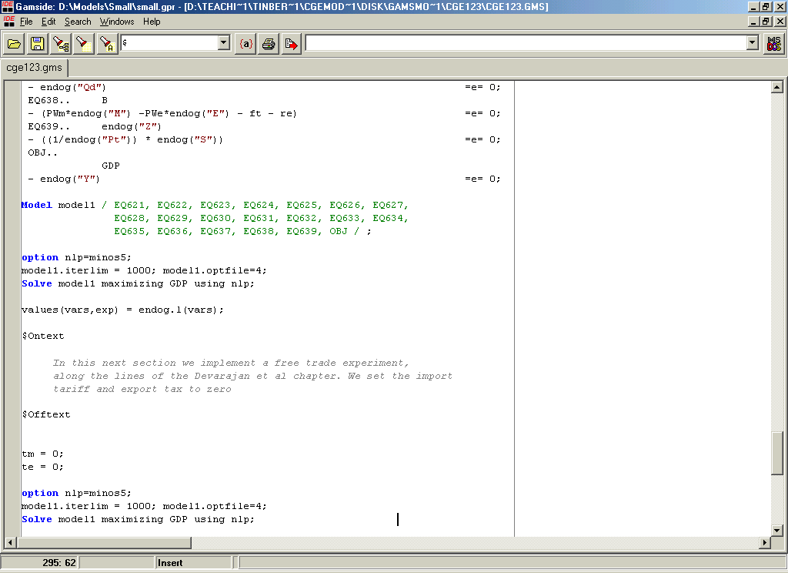
Model specification

Slide 59
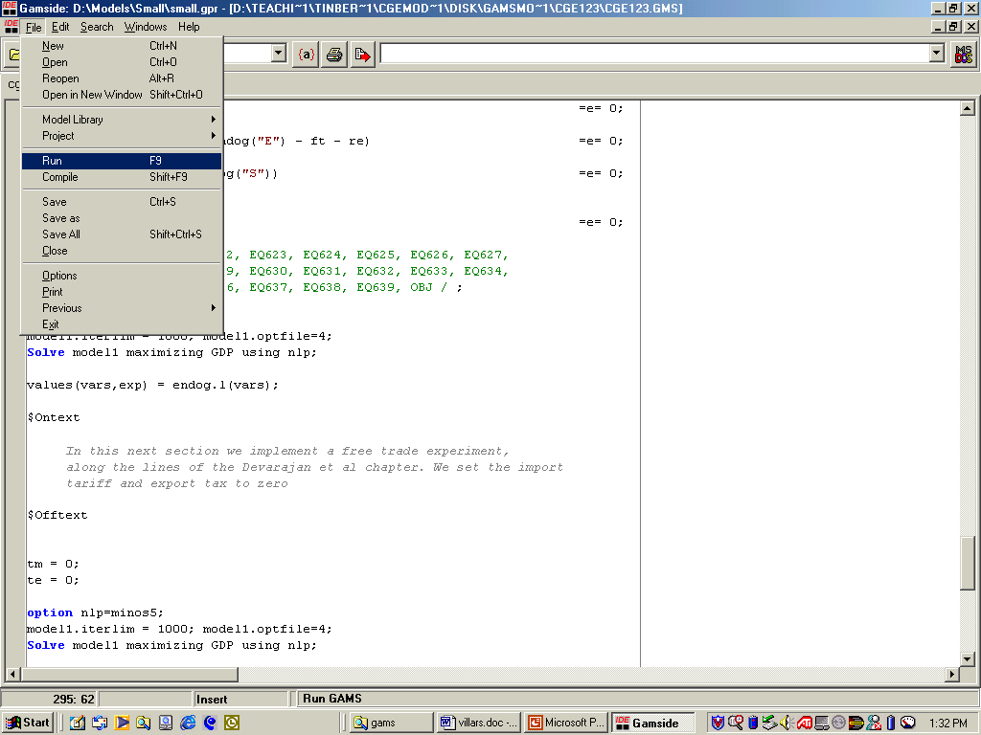
Running in GAMS IDE

Slide 60
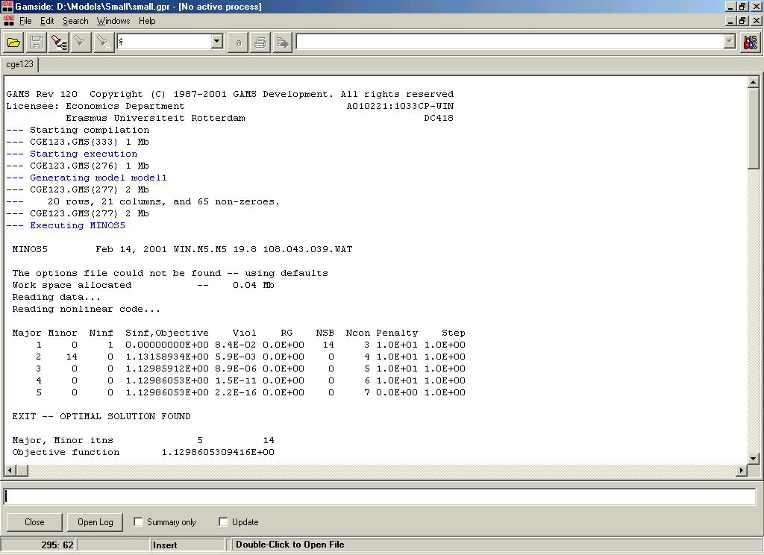
The solution screen

Slide 61
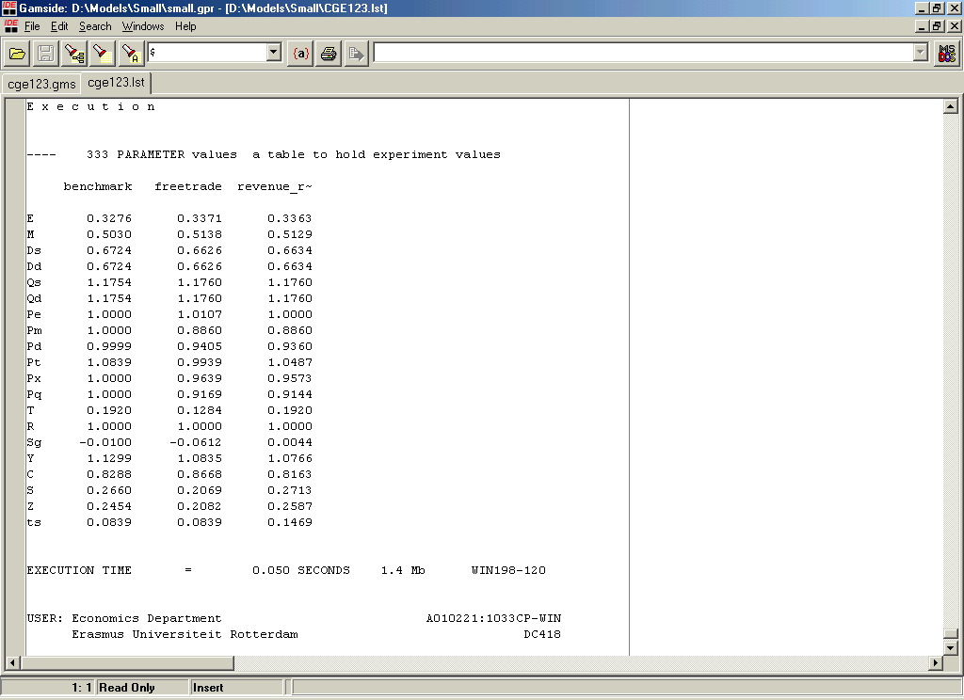
Some results

Slide 62
Thank you

